Slide 1
UML
Unified Modeling Language (UML) is a general-purpose modeling language. The main aim of UML is to define a standard way to visualize the way a system has been designed. It is quite similar to blueprints used in other fields of engineering. UML is not a programming language , it is rather a visual language.
Unified Modeling Language (UML) is a standardized visual modeling language used in the field of software engineering to provide a general-purpose, developmental, and intuitive way to visualize the design of a system. UML helps in specifying, visualizing, constructing, and documenting the artifacts of software systems.
We use UML diagrams to portray the behavior and structure of a system.
UML helps software engineers, businessmen, and system architects with modeling, design, and analysis.

Slide 2
Why do we need UML?
Complex applications need collaboration and planning from multiple teams and hence require a clear and concise way to communicate amongst them.
Businessmen do not understand code. So UML becomes essential to communicate with non-programmers about essential requirements, functionalities, and processes of the system.
A lot of time is saved down the line when teams can visualize processes, user interactions, and the static structure of the system.

Slide 3
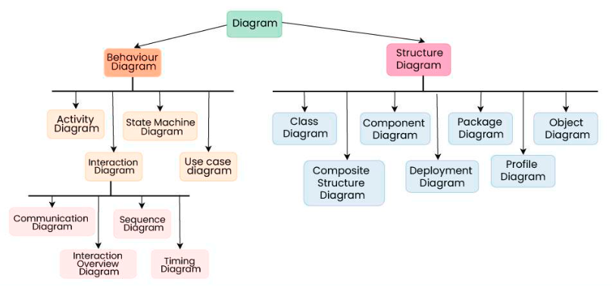
Different Types of UML Diagrams

Slide 4
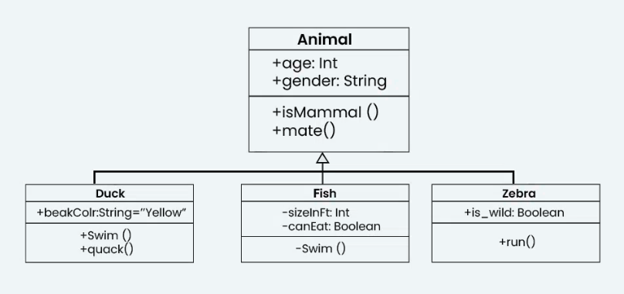
What are class Diagrams?
Class diagrams are a type of UML (Unified Modeling Language) diagram used in software engineering to visually represent the structure and relationships of classes within a system i.e. used to construct and visualize object-oriented systems.
In these diagrams, classes are depicted as boxes, each containing three compartments for the class name, attributes, and methods. Lines connecting classes illustrate associations, showing relationships such as one-to-one or one-to-many.
Class diagrams provide a high-level overview of a system’s design, helping to communicate and document the structure of the software. They are a fundamental tool in object-oriented design and play a crucial role in the software development lifecycle.
What is a class?
In object-oriented programming (OOP), a class is a blueprint or template for creating objects. Objects are instances of classes, and each class defines a set of attributes (data members) and methods (functions or procedures) that the objects created from that class will possess. The attributes represent the characteristics or properties of the object, while the methods define the behaviors or actions that the object can perform.

Slide 5
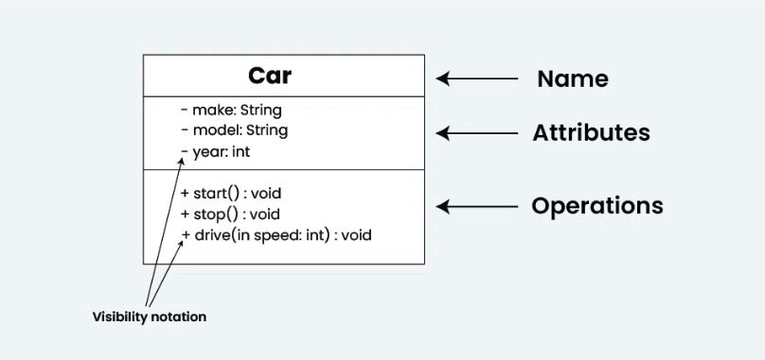
Class Name:
The name of the class is typically written in the top compartment of the class box and is centered and bold.
Attributes:
Attributes, also known as properties or fields, represent the data members of the class. They are listed in the second compartment of the class box and often include the visibility (e.g., public, private) and the data type of each attribute.
Methods:
Methods, also known as functions or operations, represent the behavior or functionality of the class. They are listed in the third compartment of the class box and include the visibility (e.g., public, private), return type, and parameters of each method.
Visibility Notation:
Visibility notations indicate the access level of attributes and methods. Common visibility notations include:
+ for public (visible to all classes)
- for private (visible only within the class)
# for protected (visible to subclasses)
~ for package or default visibility (visible to classes in the same package)

Slide 6
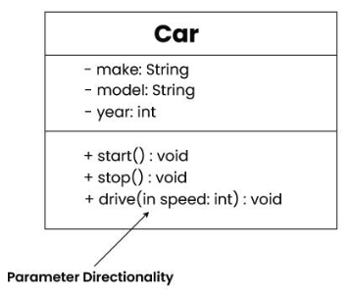
Parameter Directionality
In class diagrams, parameter directionality refers to the indication of the flow of information between classes through method parameters. It helps to specify whether a parameter is an input, an output, or both. This information is crucial for understanding how data is passed between objects during method calls.
There are three main parameter directionality notations used in class diagrams:
In (Input):
An input parameter is a parameter passed from the calling object (client) to the called object (server) during a method invocation.
It is represented by an arrow pointing towards the receiving class (the class that owns the method).
Out (Output):
An output parameter is a parameter passed from the called object (server) back to the calling object (client) after the method execution.
It is represented by an arrow pointing away from the receiving class.
InOut (Input and Output):
An InOut parameter serves as both input and output. It carries information from the calling object to the called object and vice versa.
It is represented by an arrow pointing towards and away from the receiving class.

Slide 7
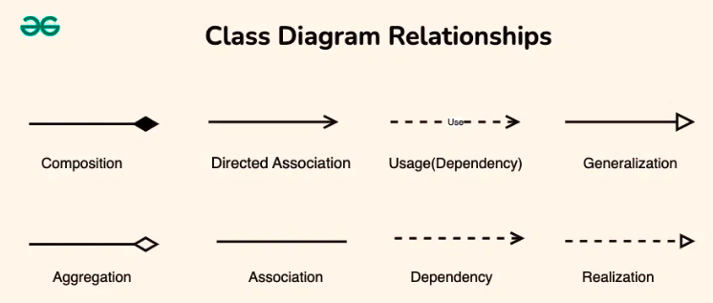
Relationships between classes
In class diagrams, relationships between classes describe how classes are connected or interact with each other within a system. There are several types of relationships in object-oriented modeling, each serving a specific purpose. Here are some common types of relationships in class diagrams:

Slide 8
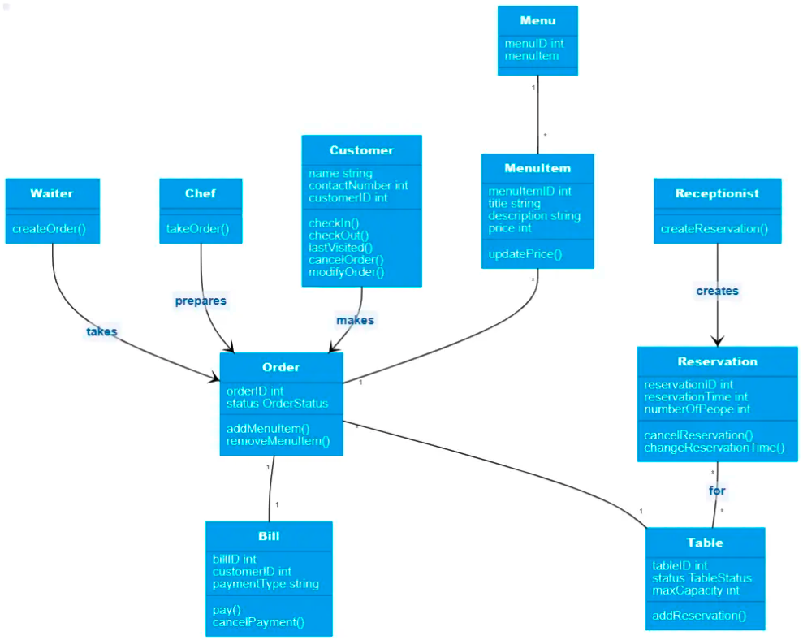
Ex: Class Diagram of Restaurant System

